Slide 1
Mental set
Quick write – ‘Probability’
Write everything you know about probability, keep writing until the time is up (2 minutes)
Share – compare what you have with the person next to you. Update your list to include items your partner has that you don’t
‘Popcorn’
Notes:
hook

Slide 2
24
7
30
Date
Title - Probability
EQ –
5
Notes:
Lesson objective (EQ)

Slide 3
Lesson objective
By the end of this lesson you will be able to;
- Recall the language associated with probability and what you have learnt so far.
Notes:
Lesson

Slide 4
Success Criteria
You will know you are successful in achieving the objective by…

Slide 5
24
7
30
Date
Title - Probability
EQ – What is probability
Probability is the chance of an event happening.
Probability Scale
Probability can be described in
Decimals
Fractions
Percentages
Words
What is the probability scale
5
Notes:
The activity needs to be done whilst going through these slides. Ie, review sample space then have students work out the sample space for the die they have etc

Slide 6
24
7
30
Date
Title - Probability
EQ – What is probability
What is sample space
Sample Space
The sample space is a list of all possible outcomes
Example – What is the sample space for the roll of one six sided die.
A normal six sided die has the numbers 1 to 6 on it, the sample space is
Sample space {1, 2, 3, 4, 5, 6}
What is the sample space for the toss of 2 coins?
Samples space {HH, HT, TH, TT}
5
Notes:
Input

Slide 7
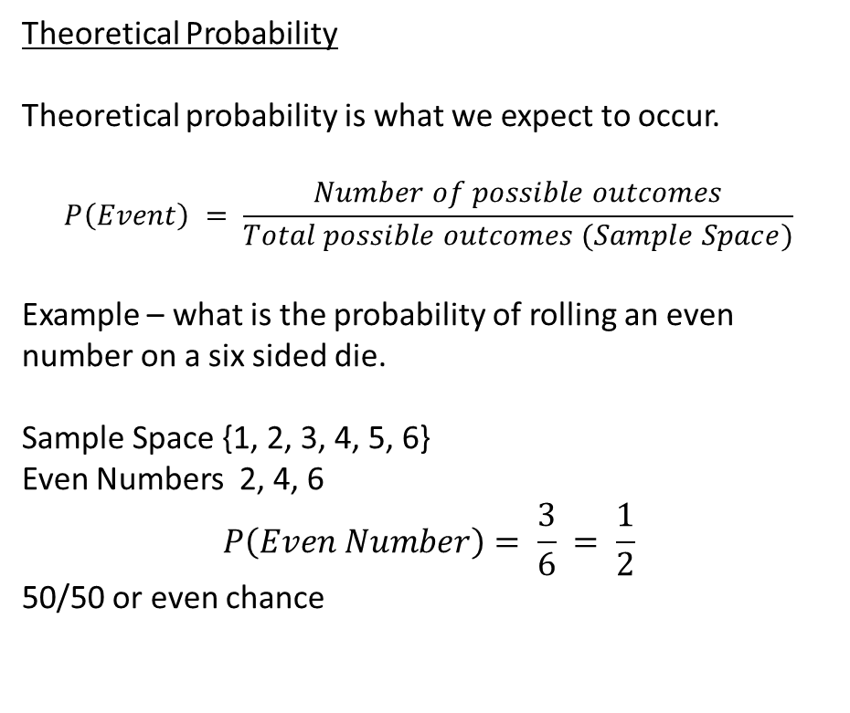
24
7
30
Date
Title - Probability
EQ – What is probability
Theoretical Probability
Theoretical probability is what we expect to occur.
$$P\left(Event\right) = \frac{Number of possible outcomes}{Total possible outcomes (Sample Space)}$$
Example – what is the probability of rolling an even number on a six sided die.
Sample Space {1, 2, 3, 4, 5, 6}
Even Numbers 2, 4, 6
$$P\left(Even Number\right)= \frac{3}{6} = \frac{1}{2}$$
50/50 or even chance
What is theoretical probability
5
Notes:
Input

Slide 8
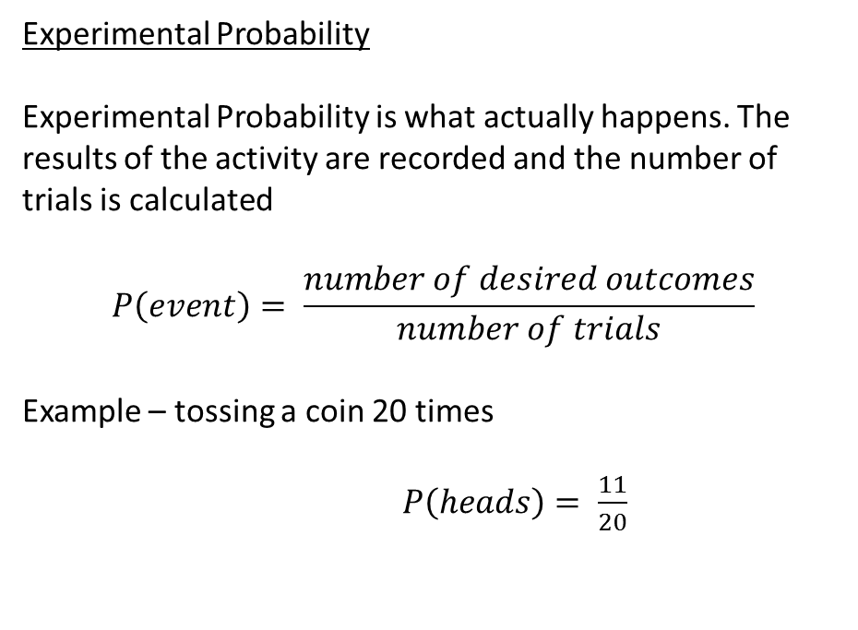
24
7
30
Date
Title - Probability
EQ – What is probability
Experimental Probability
Experimental Probability is what actually happens. The results of the activity are recorded and the number of trials is calculated
$$P\left(event\right)= \frac{number of desired outcomes}{number of trials}$$
Example – tossing a coin 20 times
$P\left(heads\right)= \frac{11}{20}$
What is experimental probability
Heads | Tails
11 | 9
5
Notes:
Input

Slide 9
Activity
To be done in conjunction with the slides
Group students into pairs or groups of 3
Each group is given a die
They are to work out sample space & theoretical probability for the die they have
They are to do 20 – 30 rolls (adjust depending on time) record results and calculate experimental probability
Notes:
Independent practice

Slide 10
Closure activity
Thumbs up
Notes:
Closure

